Slide 1
Data for Final Paper
Alexander Shin

Slide 2
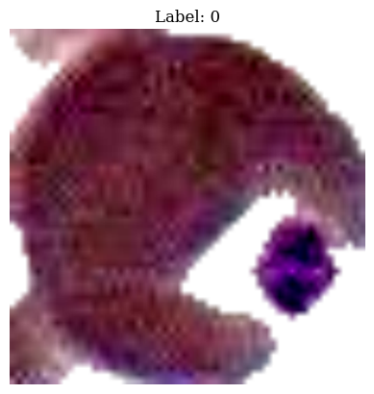
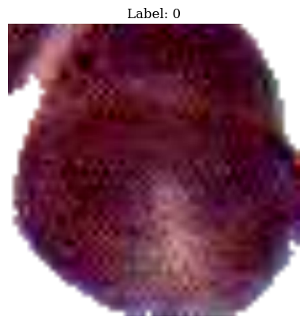
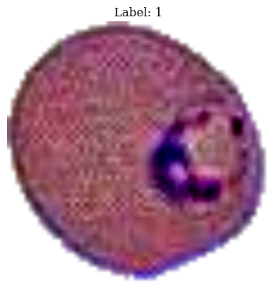
Examples of images in DW_pan dataset

Slide 3
SVM Results
Settings | Paper1 | Paper2 | Paper3 | Paper4 | Paper5 | DiffSize
diffC | 0.62295 | 0.61475 | 0.762295 | 0.72131 | 0.61475 | 0.65801
Default | 0.90984 | 0.90164 | 0.91803 | 0.91803 | 0.90164 | 0.92208
linear | 0.86885 | 0.92362 | 0.88525 | 0.92623 | 0.92623 | 0.80952
Final Acc | 0.89147 | 0.86822 | 0.89922 | 0.88372 | 0.86822 | 0.90272

Slide 4
Settings | DiffSize1 | DiffSize2 | DiffSize3 | DiffSize4 | Paper5 | DiffSize
diffC | 0.72294 | 0.73160 | 0.74892 | 0.72294
Default | 0.91342 | 0.93507 | 0.88745 | 0.9134199
linear | 0.88312 | 0.86147 | 0.86580 | 0.88312
Final Acc | 0.87549 | 0.914397 | 0.91829 | 0.87549

Slide 5
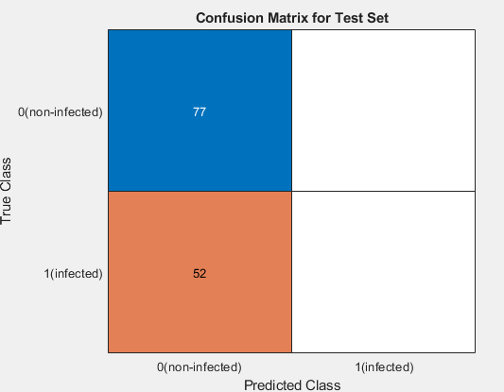
Matlab Result (Only 2 epochs) 1 validation patience (test accuracy: 59.69)

Slide 6
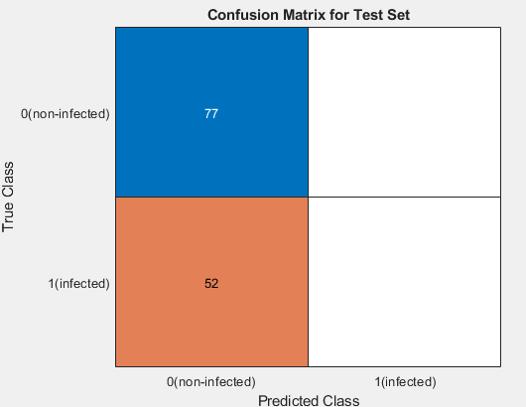
Matlab Result (Only 2 epochs) 1 validation patience (test accuracy: 59.69)

Slide 7
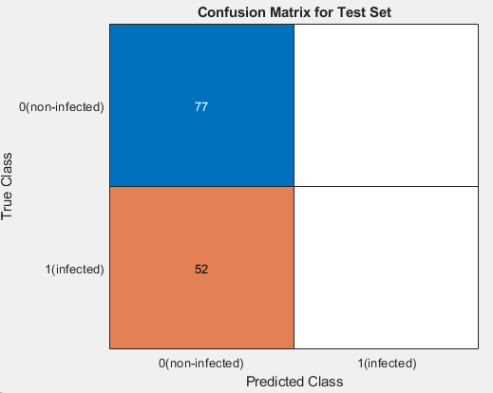
Matlab Result (Only 2 epochs) 1 validation patience (test accuracy: 59.69% )

Slide 8
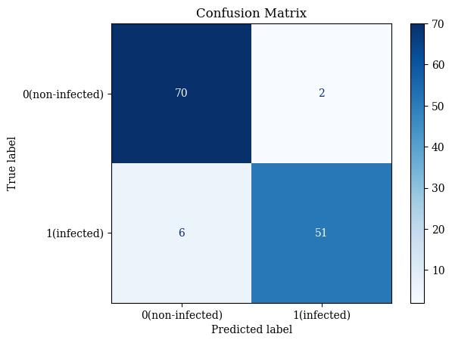

First run (Paper Settings), final acc: 0.9380 (Opera)

Slide 9
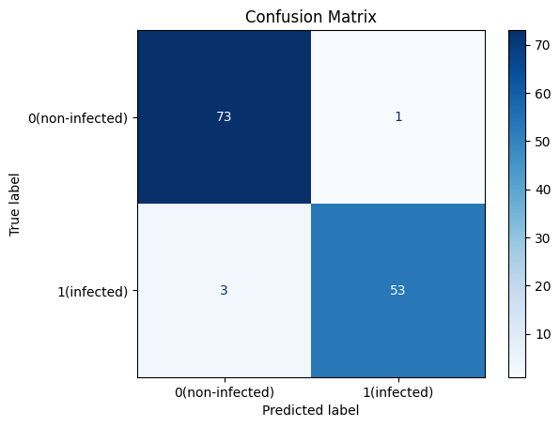

First run (Paper Settings), final acc:.9692 (chrome)

Slide 10

First run (Paper Settings), final acc:.9846 (chrome)

Slide 11
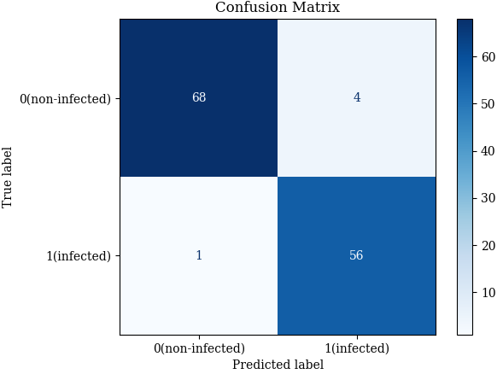

First run (Paper Settings), final acc:~.9531 (firefox)

Slide 12
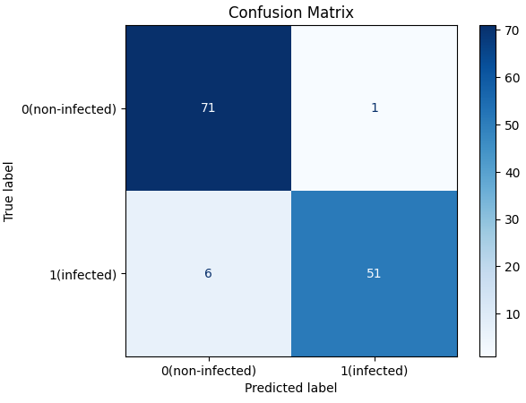

First run (Paper Settings), final acc:.9457 (edge)

Slide 13
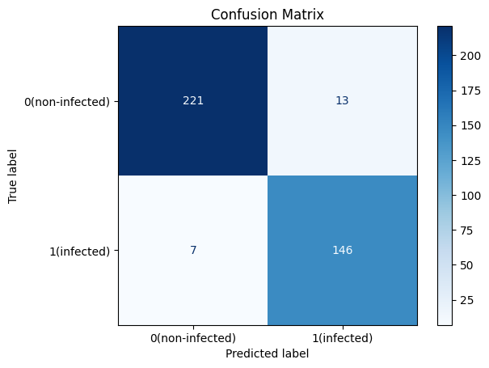
Second run (Different sizes), final acc:0.9483 (chrome)

Slide 14

Second run (Different sizes), final acc:0.9663 (firefox)

Slide 15

Second run (Different sizes), final acc:0.9508 (edge)

Slide 16

Third run (Different lr), final acc: 1 (Firefox)

Slide 17

Third run (Different lr), final acc: 0.9922 (Edge)

Slide 18

Third run (diff lr), final acc:1.0 (Chrome)

Slide 19
Third run (diff lr), final acc:0.9923 (Chrome)

Slide 20
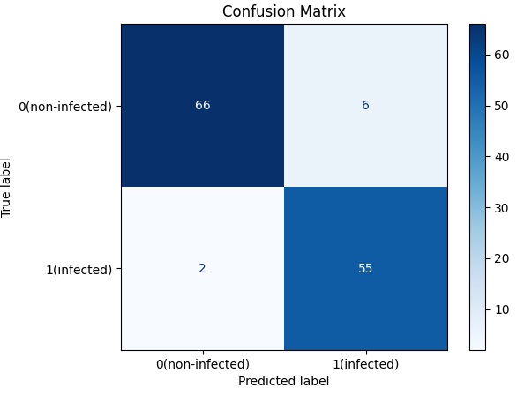
Fourth run (Different epochs), final acc:0.938 (Firefox)

Slide 21
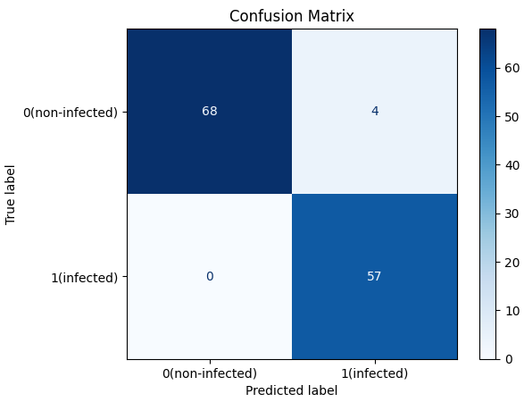
Fourth run (Different epochs), final acc:0.969 (Firefox)

Slide 22
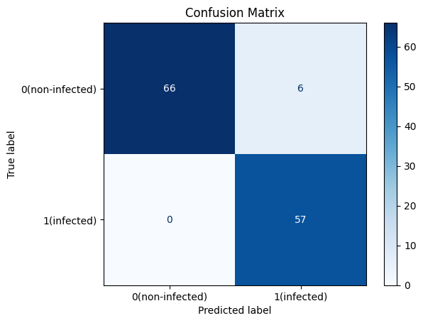
Fourth run (Different epoch), final acc:0.9535 (Opera)

Slide 23

Fourth run (Different epochs), final acc: 0.9535 (Edge)

Slide 24
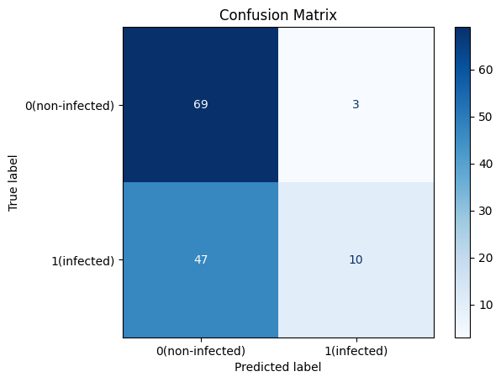
Fifth run (Different lr(big), final acc: 0.6124 (Edge)

Slide 25
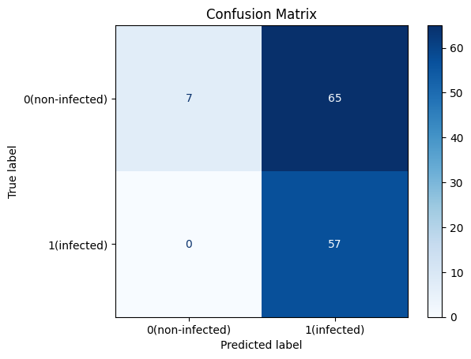
Fifth run (Different lr(big), final acc: 0.4961 (Chrome)

Slide 26

Fifth run (Different lr(big), final acc: 0.8915 (Chrome)

